Slide 1
Communication

Slide 2
Contents
Concept, structure and process
Types of communication – Formal and informal
Interpersonal and nonverbal communication
Barriers to effective communication
Enhancing effective communication

Slide 3
Communication: Meaning, process and networks
Communication means the transmission of any piece of information or understanding from a sender to receiver. It may be oral, in writing or through signs or gestures. In an organizational set up, communication is the means by which people are linked together for a common purpose, to establish a common interest or mutual understanding.
Nature/characteristics of communication
Minimum two persons
Verbal or non-verbal
Formal or informal
Persuasive action
Generally a two way process
Continuous process

Slide 4
Process of communication
Communication always takes place in a process. The process of communication is describes as follows
Sender: Sender is the person who initiates the message. He translates his thoughts, feelings into a code that is understood by other. He then transmits the message from different medium as oral, written and symbolic. For example, Maayos transmitted a message that it has decreased the price by Rs. 1. The Maayos organization is the sender in this case.
Encoding: The sender will translate his thoughts, feelings into a code that can be easily understood by others. This process is called encoding.
Message: The facts, opinions, ideas, request, suggestions etc. that is used by a sender to transmit to the receiver constitutes a message. The message can be in the form of oral, written or symbolic form.
Medium: The channel that is used by a sender to transmit the message to the receiver is called a medium. The oral medium can contain telephone, group discussion, brain storming etc. Written medium can contain reports, tippani, memo etc. Symbolic medium can contain use of hand signs, gestures etc.

Slide 5
Cont…
Decoding: Decoding is a process of translating the message into some meaningful information. This is a process that is done by the receiver. Decoding is done as per the intention of the sender.
Receiver: The person that receives the message that is sent by the sender is called a receiver. Receiver is actually the intended person for the message. For example, the general public who receive the message that is given by the Maayos organization were the receiver.
Feedback: Feedback is the process of proving response by the receiver to the sender. The response can be positive or negative. For example, in the above example, public increased the sales of the Maayos. This shows a positive response to the sender.
Noise: Noise refers to all those barriers as physical, semantic, psychological etc. that affect the communication process. The presence of noise makes the communication process ineffective.

Slide 6
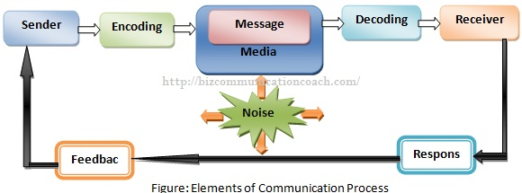
Cont…

Slide 7
Forms/Types of organizational communication
Based on means/methods used
Oral communication
By face to face conversation
Through mechanical devices
Written communication
Through letters, memos, formal reports, circulars, bulletins, policy guidelines etc.
Non-verbal communication
Through facial expressions, gestures (signal), postures etc.
Based on direction (Communication flow)
Vertical (Downward, upward and two way)
Horizontal (Interdepartmental)
Diagonal

Slide 8
Cont…
Based on the nature of relationships
Formal communication
Communication which is officially determined, regulated, and controlled
Examples: communication through official letters, notices, staff meetings etc.
Informal communication
Communication through social interaction of people rather than scalar chain of organization
It may be through grapevine (single stand chain, gossip chain, probability chain and cluster chain) or rumors.

Slide 9
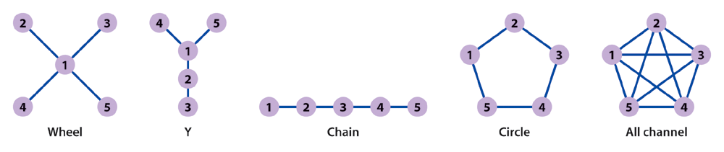
Formal communication network/structure
Communication structure is a pattern through which the members of a group of organization communicate with each other. It is also known as communication network or communication channel. The major types of communication structure or network are as follows:
Types of Communication Networks

Slide 10
Cont…
Wheel network: This structure is wheel shaped. Under this, all communication is done through one central person- a manager or a group leader. This is the most centralized structure because one person receives and disseminates all information.
Y network: This structure is Y shaped. Under this, two supervisors communicate with the single subordinate. Here 1 has two supervisors as 4 and 5 whom he has to report.
Chain network: Chain network is the vertical form of communication in which a person can communicate only with his immediate superior or subordinate. Thus it rigidly follows the formal organization structure and the chain of command.
Circle network: Circle network is the horizontal form of communication in which a person can communicate only to the persons next to his/her right or left. In meetings this form of communication generally exists.
All channel networks: This communication is free from all restrictions and thus there is free flow of communication. This form of communication structure generally exists in informal groups.

Slide 11
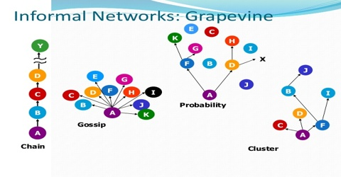
Informal communication network

Slide 12
Forms of informal communication network
Grapevine: Grapevine is the social network of informal communication. Grapevine cuts across the formal channels of communication. Hence, this is a good source of communication. John Newstrom and Keith Davis (1993) have identified four possible types of grapevine chains:
1. Single stand chain: Person A tells something to person B, who tells it to person C and so on down the line. In this chain, each person tells to the one next to him or her.
2. Gossip chain: One person seeks out and tells everyone the information of an interesting, but non-job-related nature. In this chain, one person tells the information to all.
3. Probability chain: Individuals offer information to others indifferently. In this chain, one person randomly tells the information to others.
4. Cluster chain: Person A conveys the information to a few selected individuals, some of whom then inform a few selected others. In this chain, the person tells the information to the selected ones.
The rumors: Rumors are the stories based on very little that are verifiable. A rumor is a widely spread opinion without authority for its truth. They are spread throughout the organization. A rumor has three components.
The target is the object of rumor. For example real juice contains germs
The allegation is the rumor’s point about the target
The rumor has a source, the communicator of rumor.

Slide 13
Types of Communication
The following are the common types of communication:
Formal Communication.
Informal Communication.
Interpersonal Communication (oral and written)
Non-verbal Communication.

Slide 14
Formal Communication.
In formal communication, information flows through formally defined channels.
Broadly, there are three forms of formal communication:
Downward Communication.
Upward Communication.
Horizontal / Sideward Communication.
Diagonal Communication

Slide 15
Informal Communication
In informal communication, information flows through any channel which is free from official restriction.
Informal Communication is more flexible and faster than formal communication.

Slide 16
Interpersonal Communication
In interpersonal communication, individuals or groups of individuals transmit information in face to face or through direct contact.
Oral Communication.
Written Communication.

Slide 17
Non-verbal Communication:
The transmission and receipt of messages by some medium other than oral or written is non-verbal communication.
It often relies on facial expression, body movement, physical contact, gesture etc.
It is very useful to express feelings, attitude and emotions.

Slide 18
Barriers to effective communication
Communication is an integral part of management process. But, there are a number of barriers that hinder effective communication. Different writers have classified the barriers in their own ways.
According to S. Robbins and S. Sanghi, the important barriers that retard or distort effective communication are- filtering, selective perception, information overload, emotions, communication apprehension, and the semantic problems. Likewise, Kreitner has discussed communication barriers under four broad categories, namely, process barriers, physical barriers, semantic barriers and psychological barriers. But, for our purpose, the barriers to effective communication can broadly be discussed under the following headings:

Slide 19
Cont…
Process barriers
Defects in encoding and decoding
Filtering of information by sender
Conflicting signals
Fear and mistrust between manager and subordinate
Noise
Poor listening skills
Physical barriers
Physical distance as organization departments are separated by various districts, cities, and places
Hierarchical structure: In the case of taller organization structure the communication is ineffective. There is closed door policy and employees don’t have courage to talk to high level employees
Office design: If the office of high level employees are fenced or closed
Large number of hand changes can cause distortion

Slide 20
Cont…
Semantic barriers
Words can mean different to different people
Long and complex sentence structure
Use of jargons (difficult technical words)
Psychological factors
Lack of interest of receiver
Reference groups
Perception
Technological factors
Information overloads
Poor timing
Omission
Slow or busy communication channels
Overcoming the barriers to communication/enhancing communication effectiveness/Improving communication
Describe it on the basis of barriers as I have told in the class

